Slide 1
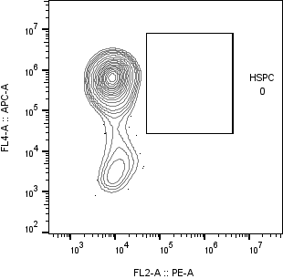
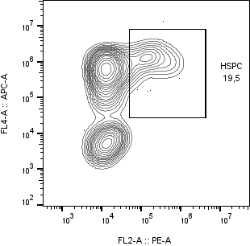
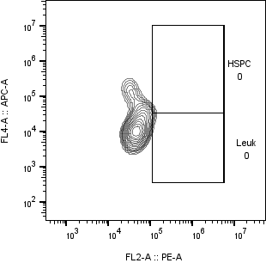
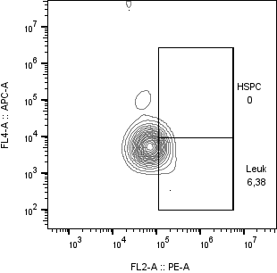
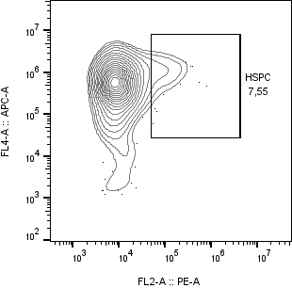
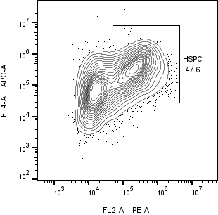
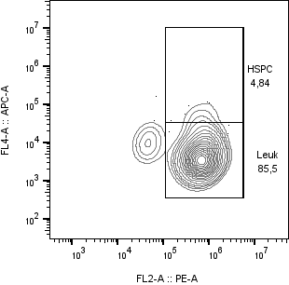
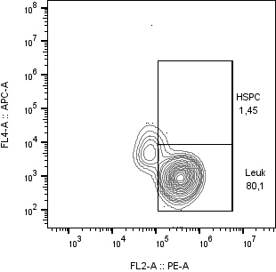
WB HD1
E8
Day 9
Day 12
Day 17
Day 20

Slide 2
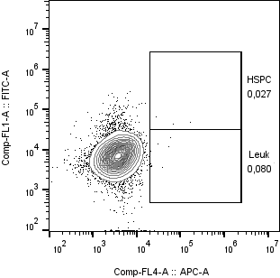
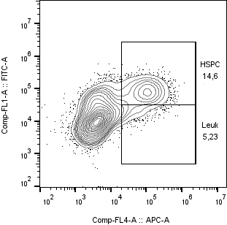
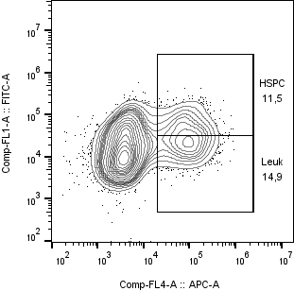
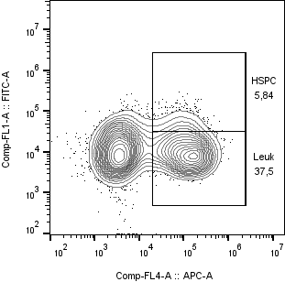
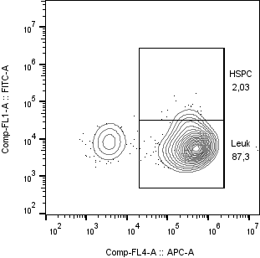
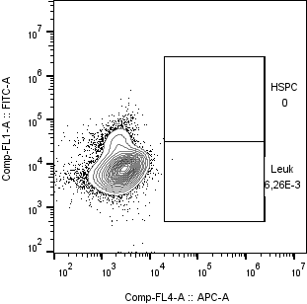
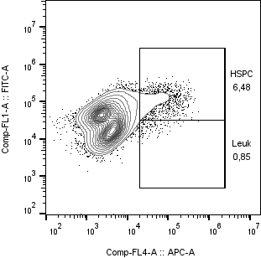
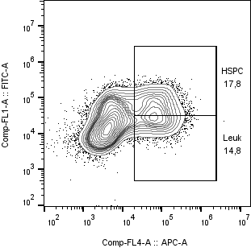
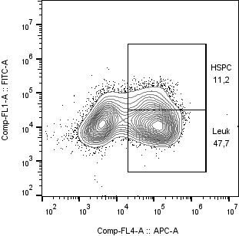
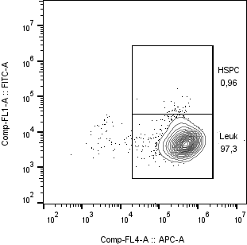
WB HD11
E8
Day 6
Day 9
Day 12
Day 18
Day 20
CD34
L4i
CD34
CD45

Slide 3
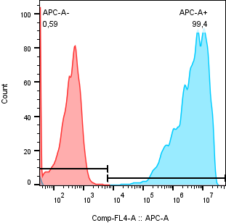
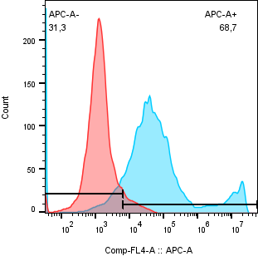
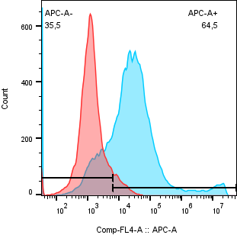
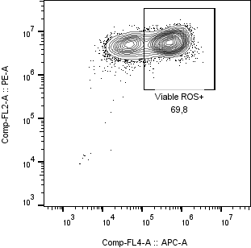
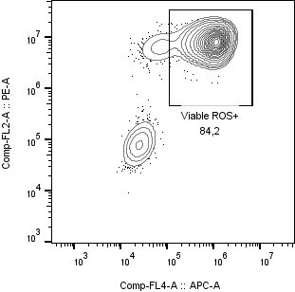
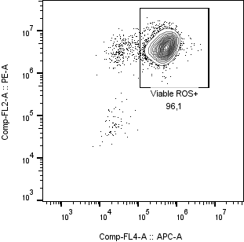
WB HD11
Count
pH Rodo [E. Coli]
Calcein AM
ROX Deep Red

Slide 4
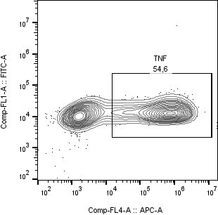
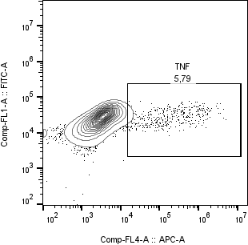

WB HD11
TNF
Notes:
Row 1: TNF gated against unstimulated stained controls and against fluorochrome controls. Also stained IL12-FITC, but 4h stimulation was apparently not long enough to elicit IL12.
Row 2, 3: Histograms from the lower chamber of the mod. Boyden chamber setup. Spontaneous migration (red) vs. Directed chemotaxis (blue). Cell size or acquisition time on the X-axis. Mind the scale of the Y-axis.

Slide 5
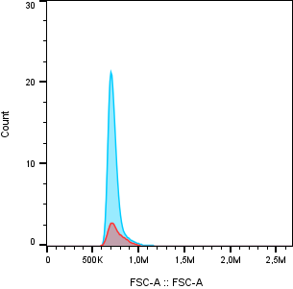
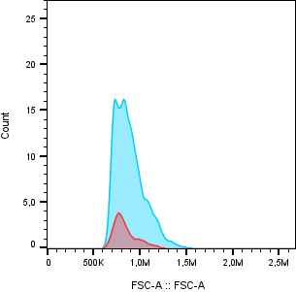
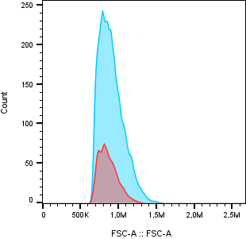
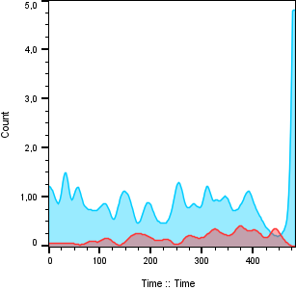
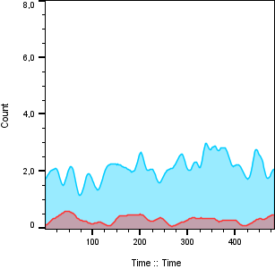
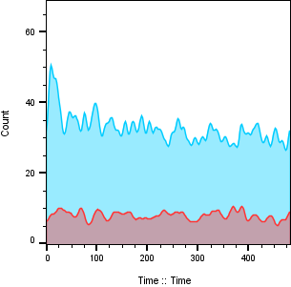
Add bar graphs
Transmigrated cells [n]

Slide 6
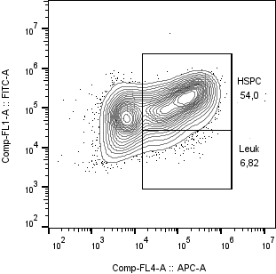
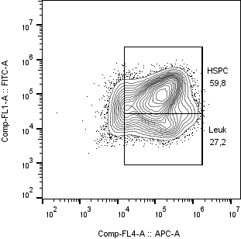
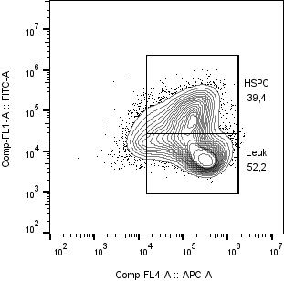
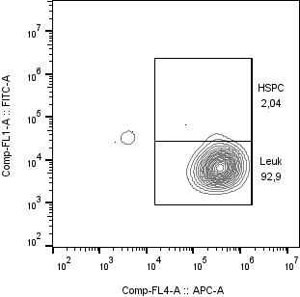
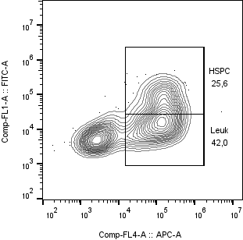
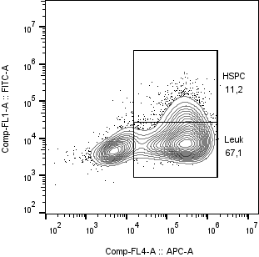
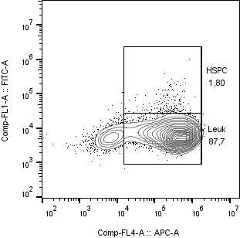
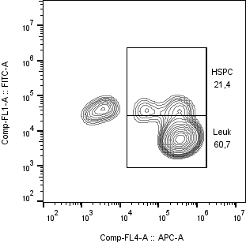
WB HD12 – HSPC / Leukocytes
Day 11
Day 13
Day 16
Day 20
CD34
CD45
Notes:
In Stemline 2 + 1:1000 ITS-X. Protocol: 3 days mesoderm, 7 days vascular, 6 days hematopoietic, Terminal maturation in M-CSF 50ng/ml + IL3 25 ng/ml.

Slide 7
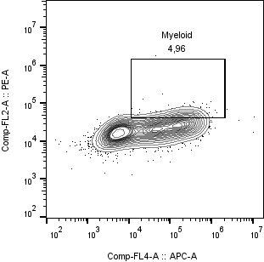
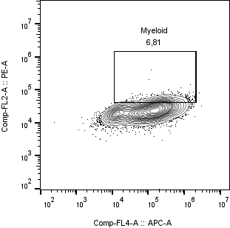

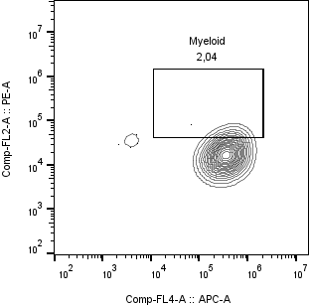
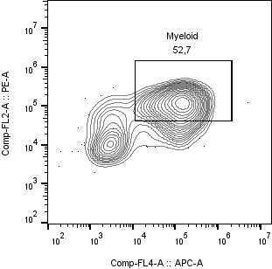
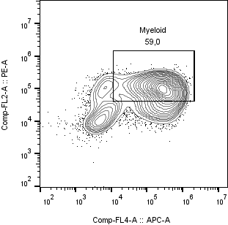
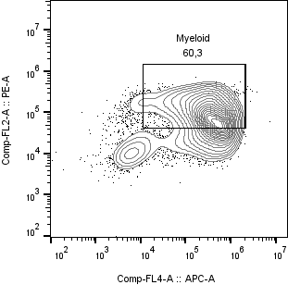
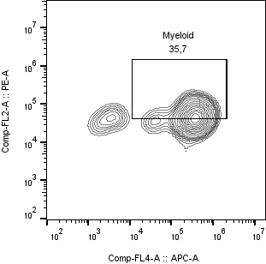
WB HD12 – Myeloid Lineage Commitment
E8
Day 11
Day 13
Day 16
Day 20
CD33
L4i
CD45
Notes:
In Stemline 2 + 1:1000 ITS-X. Protocol: 3 days mesoderm, 7 days vascular, 6 days hematopoietic, Terminal maturation in M-CSF 50ng/ml + IL3 25 ng/ml.

Slide 8
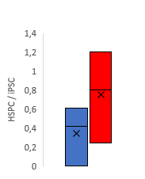
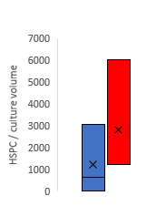
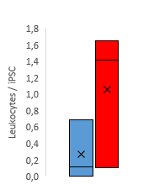

A
E
d12
d18
d20
E5C3
E8
CD34
L4i
CD45
B
C
D
F
E8
L4i
E8
L4i
E8
L4i
E8
L4i
Notes:
A) Percent of viable singlets (by FSC/SSC and confirmed by 7AAD in select tubes).
Flow cytometry for CD34+ (yellow, green), CD45+ (blue, green); -/- (grey).
B) Viable CD34+/45+ HSPC harvested on day 11-12 of culture, C) derived CD34-/45+ leukocytes on day 16-18, and D) derived myeloid cells expressing CD45 and either CD11b or CD33 on day 20-21.
E) Exemplary flow cytometry for cell line E5C3.
F) Exemplary cytospin specimens of E5C3 on day 21; HemaStain 3.
Notes:
- Add D, F.
Consider re-calculating B, C, D to be consistent with the most recent / accurate gating, instead of with the older gating in [HD1 & HD3 & HD9.xlsx](https://1drv.ms/x/c/2c6e7480743f438e/IQBojqzbrfp7SIcg4D20fRt_AeAE59NXT9bFjvx8eZk766o?e=EGljCP). Also confirm that per cell count and per culture volume calculations are accurate, as one would expect more leukocytes/iPSC based on the pronounced difference of numbers between HSPC/volume and Leukocytes/volume.
Add E5C3 ROS, Chemotaxis, and Phagocytosis below to complete this figure. Cytokine production may go into the suppl or go in here, too.

Slide 9
E32C6
d12
d17
d20
E32C4
d11
d16
d20
E8
E8
CD34
L4i
CD45
L4i
CD45
Notes:
Add CFC data for these cell lines, i.e., experiments HD1/HD12, too. For E5C3/HD11, SD had ruined the CFC by shaking, but reviewers probably won‘t notice it‘s missing, as it‘s not in the main manuscript.

